Slide 1
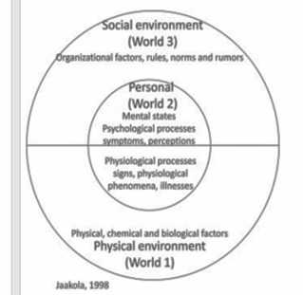
Psychosocial Environment
Health and Work
Week 4

Slide 2

Consider...
What is stress?
Is stress ever a good thing?
What is stress at work?
What causes stress at work?
How do you know someone is feeling stressed?

Slide 3

Stress
“the non-specific response of the body to any demand for change” (Selye, 1936)
“demands exceed the personal and social resources the individual is able to mobilize.” (Lazarus and Folkman, 1984)
“Stress is a pattern of stone-age reactions that occurs in response to stressor exposures... And prepares the organism for fight or flight...” (European Commission,1999).
“...stress is our body’s response to pressures from a situation or life event... When we encounter stress, our body is stimulated to produce stress hormones that trigger a ‘flight or fight’ response... This response helps us to respond quickly to dangerous situations” (Mental Health Foundation, 2018)

Slide 4
Lazarus and Folkman on Stress (1984)
"particular relationship between the person and environment that is appraised by the person as taxing or exceeding his or her resources and endangering his or her wellbeing."
Stressor = Stimulus
Stress = Response

Slide 5
Eustress (Selye, 1975)
Positive Stress
Motivates and focuses us
Is short-term
Is perceived to be within our coping ability
Improves performance
Might feel exciting

Slide 6
Distress (Selye, 1975)
Negative Stress
May cause anxiety
May cause tearfulness
May cause inability to cope with simple tasks and so decreases performance
Can lead to physical and mental problems
Feels unpleasant

Slide 7
The Stress Curve (Nixon, 1979)
STRESS PHASE
HIGH
PHYSICAL & MENTAL ACTIVITY
LOW
LOW
STRESS GROWTH
HIGH

Slide 8
Place the following words on your copy of the stress curve
Comfort zone
Eustress
Burnout
Boredom/frustration/dissatisfaction
Bad Health
Anxiety/panic/anger/violence/low self-esteem/ineffectiveness
Stress
Exhaustion
Creativity/satisfaction/progress
Optimal Activity
Hypostress
Fatigue

Slide 9
The Stress Curve (Nixon, 1979)
STRESS PHASE
HYPOSTRESS
EUSTRESS
STRESS
Creativity
Progress
Change
satisfaction
Optimal activity
HIGH
Fatigue
Exhaustion
Comfort Zone
Anxiety/panic/anger/violence/ low self-esteem/ineffectiveness
PHYSICAL & MENTAL ACTIVITY
Bad Health
Frustration
Boredom
Dissatisfaction
Burnout
LOW
LOW
STRESS GROWTH
HIGH

Slide 10
Videos about our physiological response to stress
https://youtu.be/McWFIlGbaag
https://youtu.be/jEHwB1PG_-Q
https://www.youtube.com/watch?v=m2GywoS77qc

Slide 11
How does stress make us physically ill?
Long-term suppression of cortisol – immune system suppressed, colds and illness, feeling run down.
Release of glycogen into the bloodstream – potential for build up of fatty plaques and demands increased insulin production by the pancreas.
Can increase our blood pressure during the stress episode and alter blood flow around the body.
No real evidence that it causes heart attack or stroke but raised cortisol and lifestyle are contributing factors of CHD (see Chandola et al., 2008) (Bb)
Stress isn’t evenly distributed in the population (see Thoits, 2010) (Bb)
How we cope can affect our health too as this can influence negative coping behaviours (see Chandola, 2008; Thoits, 2010)
Can also lead to psychosomatic symptoms e.g. pain, illness

Slide 12
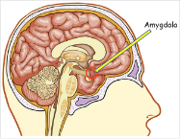
But often stress affects our mental wellbeing, why?
Amygdala – Needed for survival
A primitive response
Evokes fear and gives us some emotions and instincts.
It is also linked to memory to help our survival. i.e. What happened last time?
These in combination – control the way we perceive things

Slide 13
When does Stress Occur?
Situations that are likely to cause stress are:
Unpredictable or uncontrollable
Uncertain, ambiguous or unfamiliar
Involve conflict
Involve personal loss
Have specific or high performance expectations
Time limited events, such as the pressures of examinations or work deadlines
Ongoing situations, such as family demands job insecurity, or long commuting journeys.

Slide 14
What workplace factors influence stress?

Slide 15
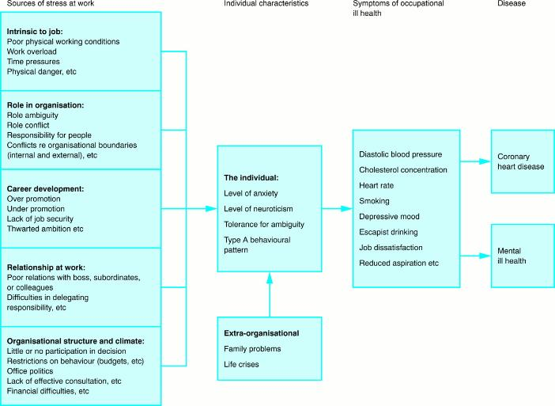

A model of stress at work.1.
This article is on Bb
Michie Occup Environ Med 2002;59:67-72
©2002 by BMJ Publishing Group Ltd
Notes:
A model of stress at work.1

Slide 16
Work-Related Stressors (Kasl, 1991)
Temporal aspects of the work day and work itself:
Shift work
Unwanted overtime or excessive hours
Two jobs
Piece work
Fast pace of work
Not enough time to complete deadlines
Scheduling of work and rest
Variation of work
Interruptions
Kasl, S.V. (1991) ‘Assessing risk in the work setting’, in Schroeder, H.E. (ed): New Directions in health psychology assessment, pp96-125, New York: Hemisphere Publishing

Slide 17
Work-Related Stressors (Kasl, 1991)
Work Content (not temporal aspects):
Fragmented, repetitive, monotonous work with low task/low skill variety
Autonomy, independence, influence, control
Utilisation of existing skills
Mental alertness and concentration
Unclear tasks or demands
Conflicting tasks or demands
Insufficient resources given to work demands or responsibilities (e.g. skills, machinery, organisation structure).
Kasl, S.V. (1991) ‘Assessing risk in the work setting’, in Schroeder, H.E. (ed): New Directions in health psychology assessment, pp96-125, New York: Hemisphere Publishing

Slide 18
Work-Related Stressors (Kasl, 1991)
Interpersonal (work group):
Opportunity to interact with co-workers (during work, breaks after after work)
Size cohesiveness of primary work group
Recognition of work performance
Social support
Instrumental support
Equitable workload
Harassment
Kasl, S.V. (1991) ‘Assessing risk in the work setting’, in Schroeder, H.E. (ed): New Directions in health psychology assessment, pp96-125, New York: Hemisphere Publishing

Slide 19
Work-Related Stressors (Kasl, 1991)
Interpersonal (Supervision):
Participation in decision making
Receiving feedback and recognition from supervisor
Closeness of supervision
Social support
Instrumental support
Unclear, conflicting demands
Harassment
Kasl, S.V. (1991) ‘Assessing risk in the work setting’, in Schroeder, H.E. (ed): New Directions in health psychology assessment, pp96-125, New York: Hemisphere Publishing

Slide 20
Work-Related Stressors (Kasl, 1991)
Organisational Conditions:
Size,
Hierarchical structure
Position in the organisation
Job prestige
Organisation - Unclear about lines of responsibility, role conflict and ambiguity
Administrative organisation – policies and procedures, red tape
Discriminatory policies e.g. hiring and firing, promotion
Kasl, S.V. (1991) ‘Assessing risk in the work setting’, in Schroeder, H.E. (ed): New Directions in health psychology assessment, pp96-125, New York: Hemisphere Publishing

Slide 21
Some Theory...
Control Demand Theory (Karasek)
Decision latitude (Karesek – Thorell – Johnson)
Effort Reward imbalance (Siegrist)
Person-environment misfit (Hackman and Oldman)

Slide 22
Psychosocial Hazards
Psychosocial factors (hazards) were defined by the ILO in 1984 as the “interactions between and among work environment, job content, organizational conditions and workers’ capacities, needs, culture, personal extra-job considerations that may, through perceptions and experience, influence health, work performance and job satisfaction”.
ILO (2016) Workplace stress: A collective challenge. Available at: https://www.ilo.org/wcmsp5/groups/public/@ed_protect/@protrav/@safework/documents/publication/wcms_473267.pdf (accessed 14 October 2018)

Slide 23
Psychosocial Hazards
Job content | Lack of variety or short work cycles, fragmented or meaningless work, under use of skills, high uncertainty, continuous exposure to people through work
Workload & work pace | Work overload or under load, machine pacing, high levels of time pressure, continually subject to deadlines
Work schedule | Shift working, night shifts, inflexible work schedules, unpredictable hours, long or unsociable hours
Control | Low participation in decision making, lack of control over workload, pacing, etc.
Environment & equipment | Inadequate equipment availability, suitability or maintenance; poor environmental conditions such as lack of space, poor lighting, excessive noise
Organisational culture & function | Poor communication, low levels of support for problem solving and personal development, lack of definition of, or agreement on, organisational objectives
Interpersonal relationships at work | Social or physical isolation, poor relationships with superiors, interpersonal conflict, lack of social support, bullying, harassment
Role in organisation | Role ambiguity, role conflict, and responsibility for people
Career development | Career stagnation and uncertainty, under promotion or over promotion, poor pay, job insecurity, low social value to work
Home-work interface | Conflicting demands of work and home, low support at home, dual career problems
Leka, Griffiths and Cox (2003) cited by Leka and Jain (2010, p5http://apps.who.int/iris/bitstream/handle/10665/44428/9789241500272_eng.pdf;jsessionid=17AC298E0CB3E885E8FE99E48FBE05A4?sequence=1

Slide 24
Organisational Stress Management
Legal Obligation
‘The Management Standards’ are guidance, however, employers already have duties:
Under the Management of Health and Safety at Work Regulations 1999: To assess the risk of stress-related ill health arising from work activities.
Under the Health and Safety at Work etc. Act 1974: To take measures to control that risk.
See: http://www.hse.gov.uk/stress/standards/downloads.htm

Slide 25
The HSE Management Standards
Represent a set of conditions that, if present:
demonstrate good practice through a step-by-step risk assessment approach
allow assessment of the current situation using pre-existing data, surveys and other techniques
promote active discussion and working in partnership with employees and their representatives, to help decide on practical improvements that can be made
help simplify risk assessment for work-related stress by:
identifying the main risk factors
helping employers focus on the underlying causes and their prevention
providing a yardstick by which organisations can gauge their performance in tackling the key causes of stress

Slide 26
THE HSE Management Standards (UK)
The six areas are:
Demands: workload, work patterns, and the work environment
Control: How much say the person has in the way they do their work
Support: encouragement, sponsorship and resources provided by the organisation, line management and colleagues
Relationships: promoting positive working to avoid conflict and dealing with unacceptable behaviour
Role: Whether people understand their role within the organisation and whether the organisation ensures that they do not have conflicting roles
Change: How organisational change (large or small) is managed and communicated in the organisation.

Slide 27
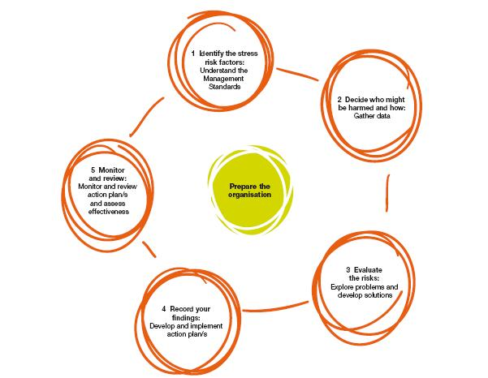
The Management Standards Approach (HSE)
HSG218 (2007)

Slide 28
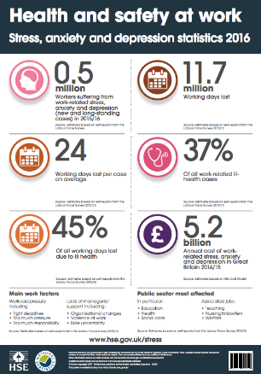
Understand the problem
Gather data
Data that can be used, includes:
Sickness absence data
Employee turnover
Exit interview
Productivity data
Performance appraisals
Informal talks with employees
Focus groups
Surveys
Return to work interview

Slide 29
The Boorman Review, 2009
Improving organisational Behaviour and Performance in the NHS:
Staff health and wellbeing impacts on patient safety, patient experience and effective care.
Staff health and wellbeing needs to be proactive:
includes a positive workplace culture
staff health and wellbeing viewed as a priority
Centred on prevention
NHS leaders and managers equipped to support and contribute to this approach, and recognise its importance in the wider picture
Aligned to Public Health priorities
Working in partnership/allowing staff voice

Slide 30
What does leadership look like? What sort of leadership is required?

Slide 31
Senior Leadership Role
Consistent approach
Lead from the top
Ensure the organisation actively supports a positive approach to health and wellbeing
Policies and procedures in place and followed
Arrange reviews of the situation and progress
Provide support and training for managers
Ensure that access services are available
Social and organisational justice
Act as a model of the behaviours you expect to see in your organisation
Enable a culture that values trust and collaboration
See https://www.nice.org.uk/guidance/ng13

Slide 32
Line Managers Role
Ensure that line managers are trained
Ensure that 2-way communication and feedback is supported
Find ways to help staff feel motivated and committed to the organisation
Evaluate morale and seek staff views about human resources and staffing issues
Give time for training and access to resources
Behave with concern for the health and wellbeing of employees
See https://www.nice.org.uk/guidance/ng13

Slide 33
The Positive Leadership Style
encouraging creativity, new ideas and exploring new ways of doing things and opportunities to learn
offering help and encouragement to each employee to build a supportive relationship; acting as a mentor or coach; being open and approachable to ensure that employees feel free to share ideas; recognising the contribution of each employee
having a clear vision which can be explained and made relevant to employees at all levels; ensuring employees share the same motivation to fulfil their goals
becoming role models who are trusted and respected by employees
providing a sense of meaning and challenge, and building a spirit of teamwork and commitment.
See https://www.nice.org.uk/guidance/ng13

Slide 34
The Leadership Approach
consult regularly on daily procedures and problems
promote employee engagement and communication
recognise and praise good performance
work with employees to produce and agree employees' personal development plans
be proactive in identifying and addressing issues and concerns early, and take preventive action at the earliest opportunity, identifying sources of internal and external support.
See https://www.nice.org.uk/guidance/ng13

Slide 35
Leadership Avoids Negative Behaviours
Such as:
detachment from colleagues and ignoring employees' suggestions
failure to monitor and manage employees as a group
showing no interest in employees' ideas and projects
feeling threatened by competent employees
being guarded in communications, such as withholding information from colleagues and not keeping them fully informed.
See https://www.nice.org.uk/guidance/ng13

Slide 36
What could employers do to help improve mental wellbeing and especially stress at work?

Slide 37
What could employers do to help improve mental wellbeing at work?
Open and Honest Communication/listening
Understanding and Empathy
Treating each other with trust and respect
Offering Flexibility to Work hours and practice
Provide Wellbeing Programmes
Acknowledge employees ideas for improving the workplace
Opportunities for personal development/learning
Opportunities for career progression
Time to stop and restful breaks
Being clear about the bigger picture

Slide 38
Fictitious Case Study
Ofsted recently visited Hartwich Secondary Comprehensive School and gave it a rating of ‘failing’. They noted pupil behaviour was poor, that 12 of 50 staff had recently left or were absent citing stress or mental health issues.
The school is in one of the poorest parts of the country and the school receives pupil premium for 60% of its pupils. The school has a high number of teen pregnancies, a drug and alcohol unit, and a gang and sexual exploitation worker. Parents routinely are abusive to staff and students, and the police or social services are present at the school at least once each week. The newly appointed head has asked you to help him address the stress levels in his staff.
In preparing how you will support the head, please address the following:
What do you consider the issues are?
What steps are required to address staff stress in the environment?
What theory underpins your approach?
Are there any examples of best practice to support your approach?
Who needs to be involved and why?
What sort of management/leadership is required?
What are the challenges going to be?
What are the head’s legal obligations in this situation?
How will you evaluate your health promoting activity?

